Slide 1
LEARNING PYTHON
20220928

Slide 2
AGENDA
1
LEARNING PYTHON
2
INPUT AND OUTPUT
3
DATA TYPES
4
OPERATORS

Slide 3
LEARNING PYTHON
20220928

Slide 4
CONTENT
What is Python?
Python Jobs
Why to Learn Python?
Python Online Interpreter
One
Two
Google Colab
Python Codes

Slide 5
What is Python?
Python is a very popular general-purpose interpreted, interactive, object-oriented, and high-level programming language. Python is dynamically-typed and garbage-collected programming language. It was created by Guido van Rossum during 1985- 1990. Like Perl, Python source code is also available under the GNU General Public License (GPL).

Slide 6
Python Jobs
Python is very high in demand and all the major companies are looking for great Python Programmers to develop websites, software components, and applications or to work with Data Science, AI, and ML technologies.
Today a Python Programmer with 3-5 years of experience is asking for around $150,000 annual package and this is the most demanding programming language in America. Though it can vary depending on the location of the Job. It's impossible to list all of the companies using Python, to name a few big companies are Google, Intel, NASA, PayPal, IBM, and many more...

Slide 7
Why to Learn Python?
Python is consistently rated as one of the world's most popular programming languages. Python is fairly easy to learn, so if you are starting to learn any programming language then Python could be your great choice. Today various Schools, Colleges and Universities are teaching Python as their primary programming language. There are many other good reasons which makes Python as the top choice of any programmer:
Python is Open Source which means its available free of cost.
Python is simple and so easy to learn
Python is versatile and can be used to create many different things.
Python has powerful development libraries include AI, ML etc.
Python is much in demand and ensures high salary

Slide 8
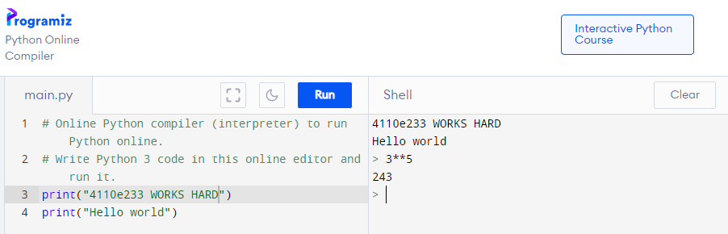
Python Online Interpreter: One
INTERACTIVE

Slide 9
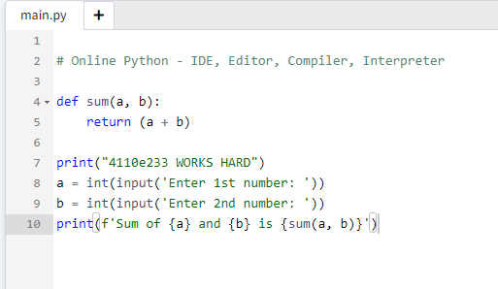
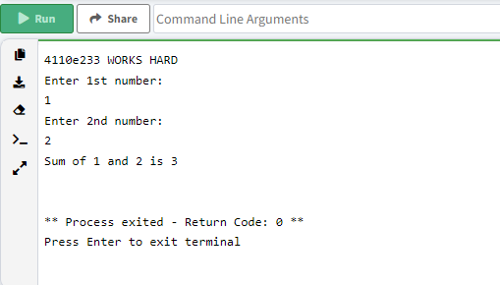
Python Online Interpreter: Two

Slide 10
INPUT AND OUTPUT
20220928

Slide 11
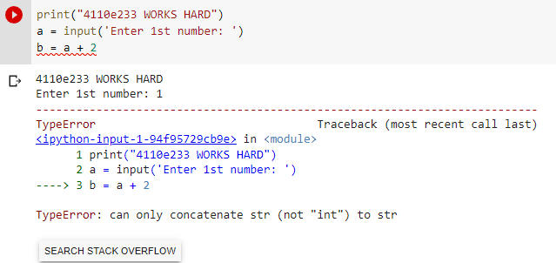
Question:
Data type

Slide 12
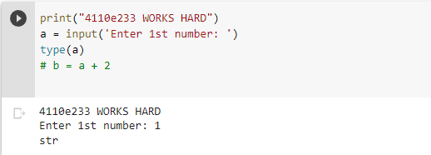

Slide 13
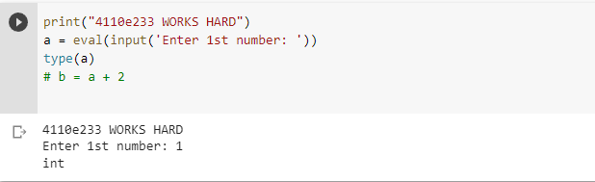

Slide 14
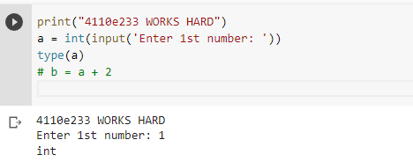

Slide 15
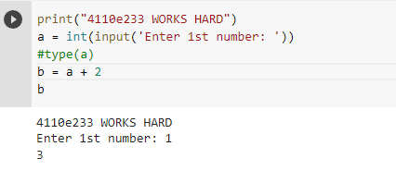
Answer: 1

Slide 16
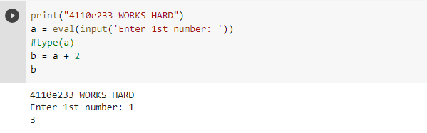
Answer: 2

Slide 17
PYTHON DATA TYPES
20220928

Slide 18
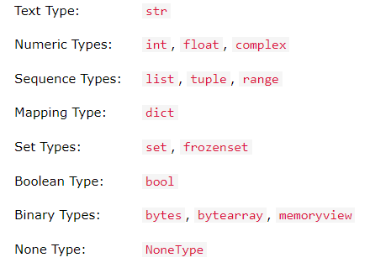
Data Types

Slide 19
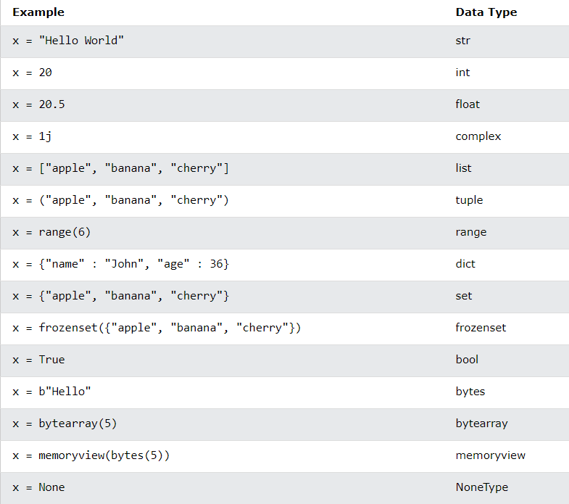

Slide 20
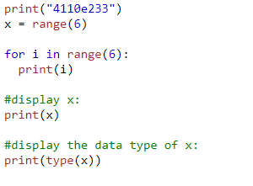
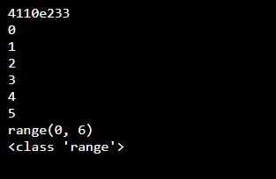

Slide 21
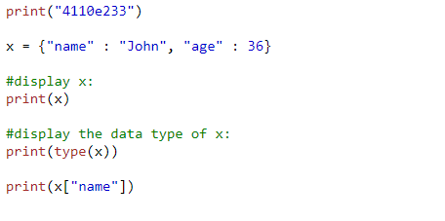
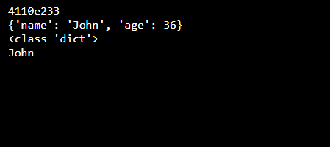
dict: key-value pair

Slide 22
PYTHON OPERATORS
20220928

Slide 23
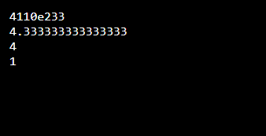
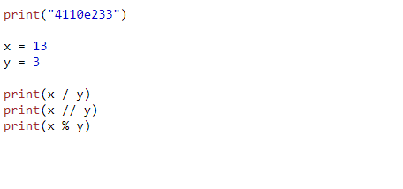
Python Arithmetic Operators

Slide 24
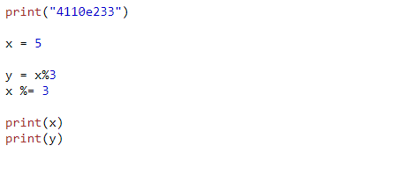
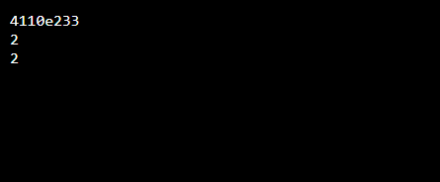
Python Assignment Operators

Slide 25
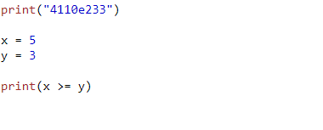
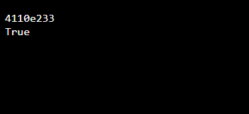
Python Comparison Operators

Slide 26
Python Comparison Operators
["apple", "banana"]
["apple", "banana"]
z = x
z
x
y
x is y == > False
x == y == > True

Slide 27
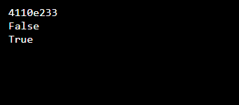
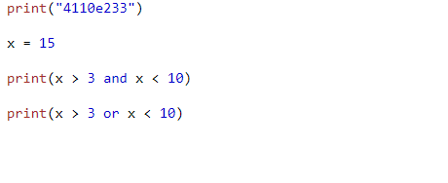
Python Logical Operators

Slide 28
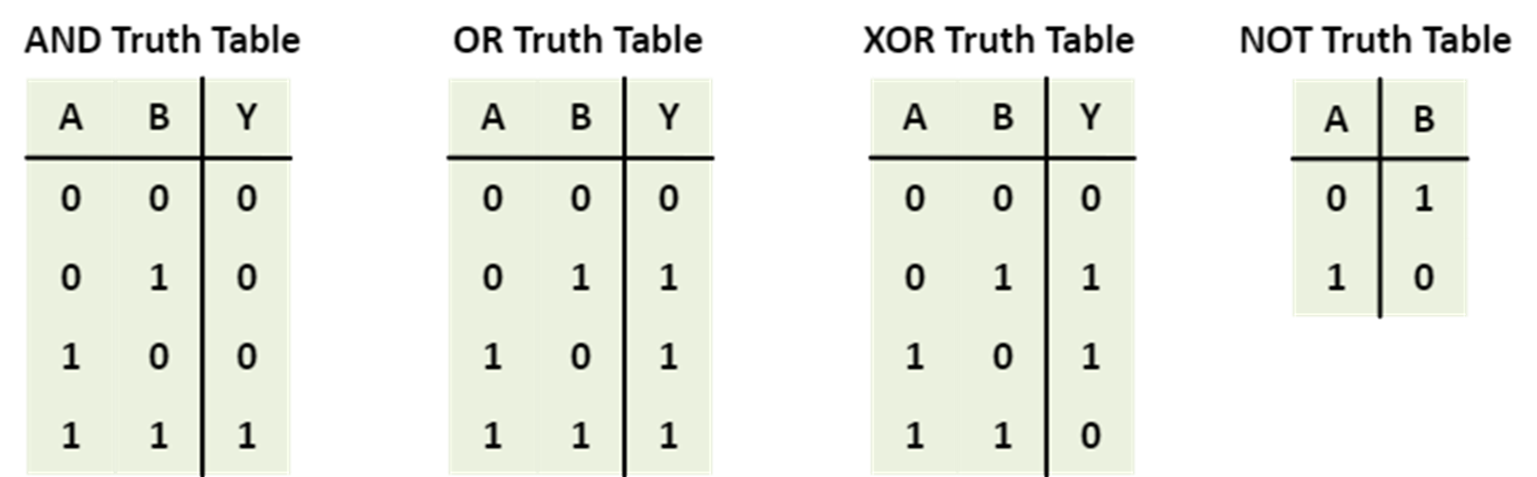
Python Bitwise Operators
1 == > true 0 == > False

Slide 29
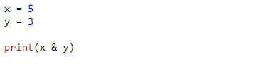
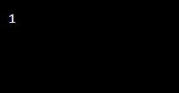
Python Bitwise Operators
binary
1*2²+0*2¹+1*2⁰
x = 5
y = 3
print(x & y)
(101)₂
(011)₂
(001)₂

Slide 30
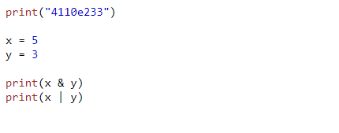
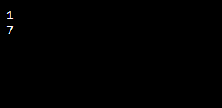
Python Bitwise Operators

Slide 32
Thanks

